Slide 1
Lists and Tuples an Introduction

Slide 2
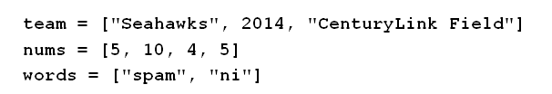
The list Object
A list is an ordered sequence of Python objects
Objects can be of any type
Objects do not have to all be the same type.
Constructed by writing items enclosed in square brackets … items separated by commas.

Slide 3
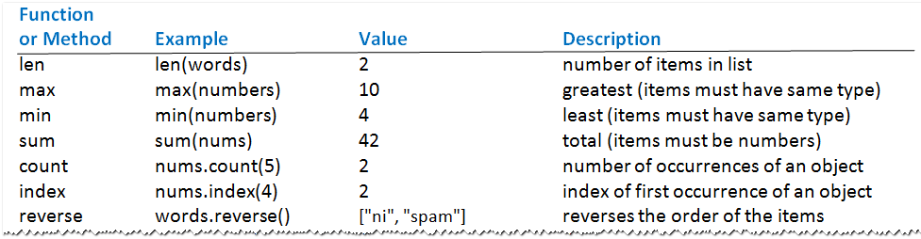
The list Object
Table 2.5 List operations (The lists team, num, and words given in previous slide)

Slide 4
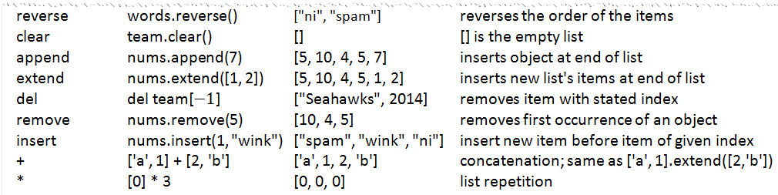
The list Object
Table 2.5 List operations (The lists team, num, and words given in previous slide)

Slide 5
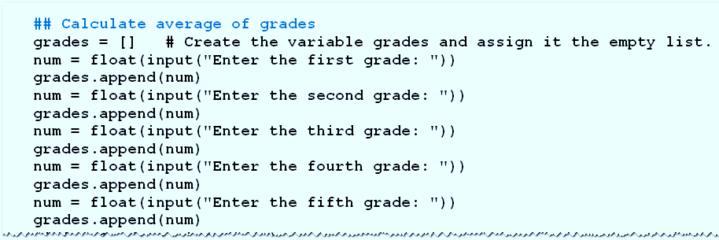
The list Object
Example 1: Program requests five grades as input, displays average after dropping two lowest grades

Slide 6
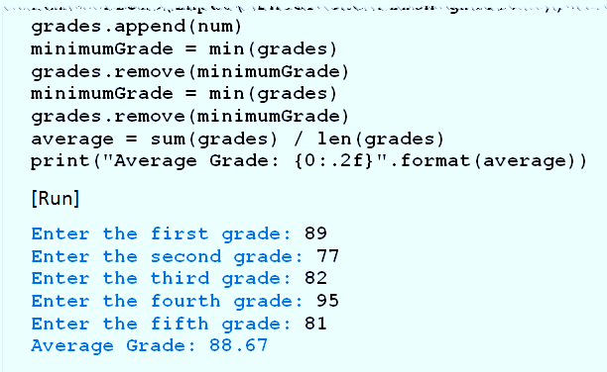
The list Object
Program requests five grades as input, displays average after dropping two lowest grades

Slide 7
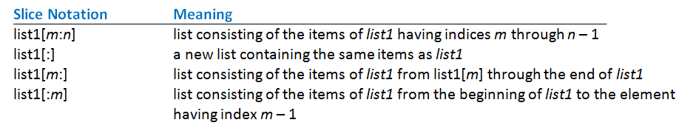
Slices
A slice of a list is a sublist specified with colon notation
Analogous to a slice of a string
Table 2.6 Meanings of slice notations

Slide 8
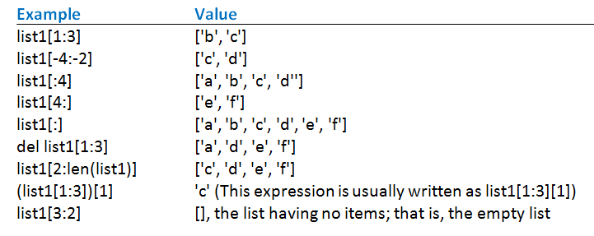
Slices
Table 2.7 Examples of slices where list1 = ['a', 'b', 'c', 'd', 'e', 'f'].

Slide 9
The split and join Methods
Split method turns single string into list of substrings
Join method turns a list of strings into a single string.
Notice that these methods are inverses of each other

Slide 10
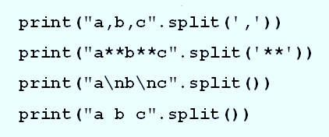
The split and join Methods
Example 2: These statements each display list ['a', 'b', 'c'].

Slide 11
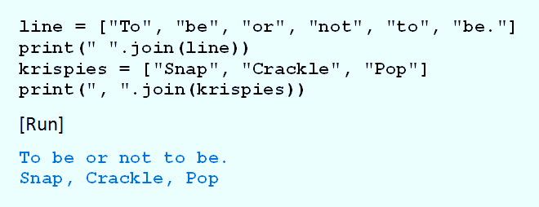
The split and join Methods
Example 3: Program shows how join method used to display items from list of strings.

Slide 12
The tuple Object
Tuples, like lists, are ordered sequences of items
Difference – tuples cannot be modified in place
Have no append, extend, or insert method
Items of tuple cannot be directly deleted, sorted, or altered

Slide 13
The tuple Object
All other list functions and methods apply
Items can be accessed by indices
Tuples can be sliced, concatenated, and repeated
Tuples written as comma-separated sequences enclosed in parentheses
Can also be written without the parentheses.

Slide 14
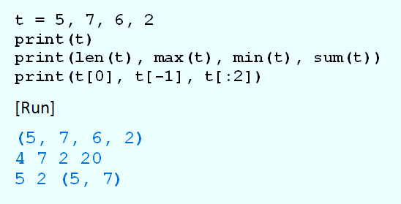
The tuple Object
Example 4: Program shows tuples have several of same functions as lists.

Slide 15
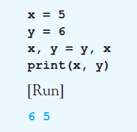
The tuple Object
Example 5: Program swaps values of two variables

Slide 16
Nested Lists
Beside numbers or strings, items can be lists or tuples.
Consider a list of tuples named L L[0] is the first tuple L[0][0] is the first item in the first tuple
And L[-1] is the last tuple L[-1][-1] is the last item in the last tuple

Slide 17
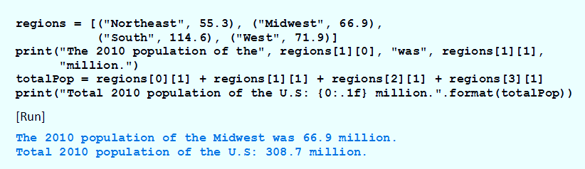
Nested Lists
Example 6: Program manipulates regions contains four tuples, each tuple gives name and 2010 population (in millions) of a region

Slide 18
Immutable and Mutable Objects
An object is an entity
Holds data.
Has operations and/or methods that can manipulate the data.
When variable created with assignment statement
Value on the right side becomes an object in memory
Variable references (points to) object

Slide 19
Immutable and Mutable Objects
When list altered
Changes made to the object in list's memory location
Contrast when value of variable is number, string, or tuple … when value changed,
Python designates a new memory location to hold the new value
And the variable references that new object

Slide 20
Immutable and Mutable Objects
Another way to say this
Lists can be changed in place
Numbers, strings, and tuples cannot
Objects changed in place are mutable
Objects that cannot be changed in place are immutable

Slide 21
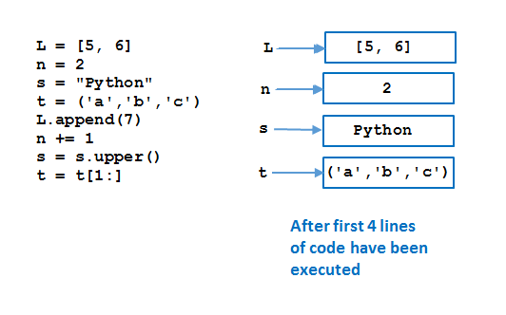
Immutable and Mutable Objects
FIGURE 2.29 Memory allocation corresponding to a program.

Slide 22
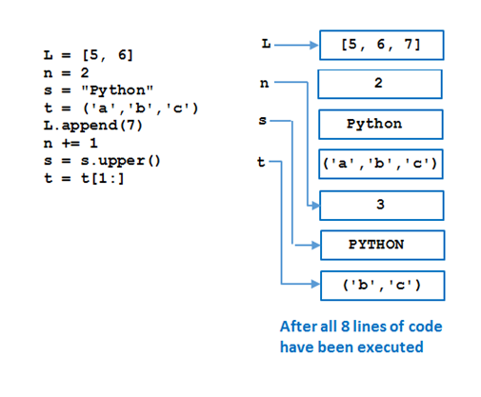
Immutable and Mutable Objects
FIGURE 2.29 Memory allocation corresponding to a program.

Slide 23
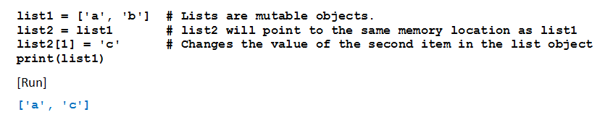
Copying Lists
Consider results of this program
All because lists are mutable

Slide 24
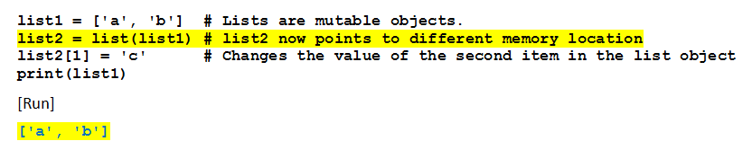
Copying Lists
Now note change in line 2
Third line of code will not affect memory location pointed to by list1

Slide 25
Indexing, Deleting, and Slicing Out of Bounds
Python does not allow out of bounds indexing for individual items in lists and tuples
But does allow it for slices
Given list1 = [1, 2, 3, 4, 5]
Then print(list1[7]) print(list1[-7]) del list1[7]

Slide 26
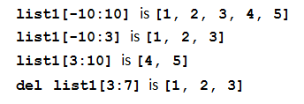
Indexing, Deleting, and Slicing Out of Bounds
If left index in slice too far negative
Slice will start at the beginning of the list
If right index is too large,
Slice will go to the end of the list.

Slide 27
End

